Slide 1
HIRING LIKE A PRO
It‘s not who I am underneath, but what I do that defines me. –Batman-
Notes:
Thank you for joining us today and welcome. Before we start, who do we have on board? Do you know each other? If not, could you shortly introduce yourself and your role in Y Soft?

Slide 2
GROUND RULES
TIMING
  9:00 – 10:10 Block 1
  10:10 – 10:20: Coffee Break
  10:20 – 11:45 Block II
  11:45 – 12:15 Lunch
  12:15 – 13:25 Block III
  13:25: 13:35 Coffee Break
  13:45 – 15:00 Block IV
QUESTIONS & DISCUSSION
  Welcomed! Sharing is caring.
CAMERAS
  Switch them on when speaking or discussing, please.
HANDBOOK
  You‘ve just received a full script. Use it to make notes if you wish.
Notes:
Ok, before diving deep into the agenda, this is how today will look like (describe the timing). Does the time schedule fit everyone? Do we need to adjust it?
This training was designed to support discussion. There’s generally no dogma in hiring and there are many angles on each of the topics we’ll be talking about. It’s ok to ask questions. We’ll also have some discussion that requires your active participation and we’ll be very happy if you share your experience with the topics we’ll be talking about.
When it comes to note taking, you have also received (or you will receive) a handbook, which is basically a rich transcript of what’s being said today, accompanied by additional materials so it should be easy for you to go back whenever needed or build on what you've learned today.
Any organizational questions before we start?

Slide 3
TABLE OF CONTENTS
01
02
03
04
05
06
Intro
Strategy
Process
That‘s where we are
Principles, candidate experience, EB
Flow, roles, tooling
Best Practices
Try Outs
Wrap Up
Candidate requirements, interviewing, bias
Ain‘t no learning without training
This is just the beginning!
Notes:
So this is what today will be about.
Intro – that’s what we’re finishing right now.
Strategy – it’s important to start with why it is important to hire like a pro and this section is exactly about that. We’ll talk about Y Soft’s hiring principles and the why behind them. We’ll also touch upon the candidate experience and the Employer Branding strategy.
Process – In the process section, this won’t be about teaching you how to follow the hiring process since you can find that on Clerbo quite easily. Instead it is more about explaining its context so it all clicks together. We’ll also discuss distribution of work in the hiring team and give you some tooling introduction.
Best practices – This section will provide practical tips for hiring. Starting with a candidate requirements definition which helps you in the selection process, through to the hiring process design, and asking the right questions and working with bias.
Try Outs – This is where we’ll put into practice what we have learned. There will be a bit of role playing.
Any questions about the agenda?

Slide 4
01
INTRO
Breaking the ice
Notes:
Ok, before we dive deep.. (go to next slide.)

Slide 5
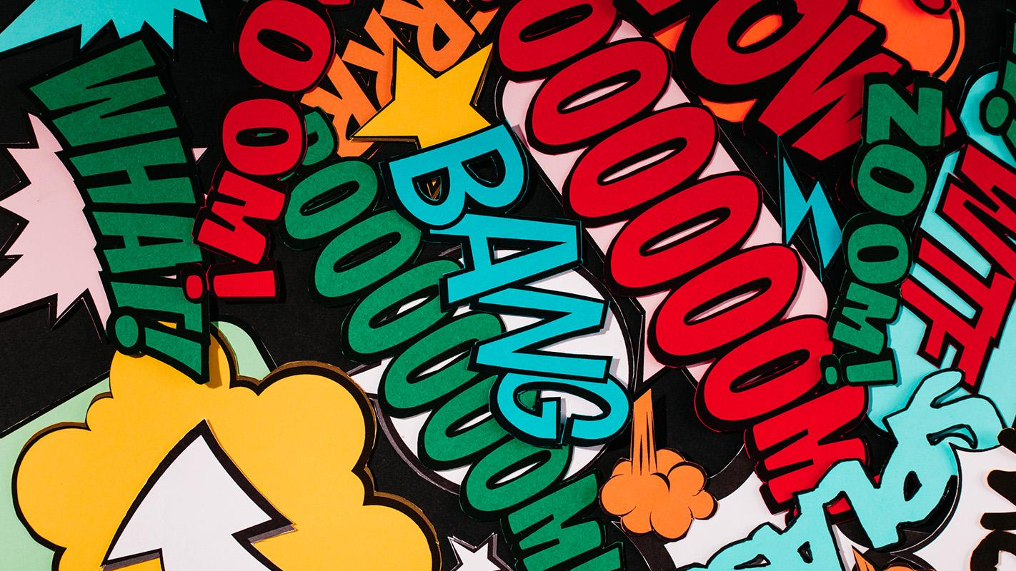
YOUR (EXTRA)ORDINARY HIRING EXPERIENCE
Notes:
To break the ice – I believe each of you has been through some type of hiring process – whether it was as an interviewer or as a candidate. Would you mind sharing some highlights? Feel free to share either pleasant or unpleasant experiences but please leave out names of companies and definitely leave out the names of the people involved.
Round Sharing: ‘My extraordinary hiring experience’ either negative or positive, interviewer or candidate. The presenter starts (make sure to bring something juicy but remember and also inform others – no names).

Slide 6
02
STRATEGY
Hiring principles, candidate experience, employer brand
Notes:
Why we speak so much about working on our hiring skills? Why do we invest all this time into training you? The first reason is pretty obvious – everything we do as the company, our failure or success is directly dependent on people we have. People usually realize this so there’s no need to discuss this further. But why don´t we rely more on the benefit of doubt and why not let the probation period reveal true colors of the newly hired Y Softer?

Slide 7

MONEY (CZK), TIME, ENERGY
501k CZK
 | HIRING | 1ST MONTH | 2ND MONTH | 3RD MONTH
PROMO/TOOLS | 16k
ONBOARDING |  | 28k | 28k | 28k
INTERVIEWS | 21k
RECRUITER | 51k
REFERRAL |  | 29k
EMP COST |  | 100k | 100k | 100k
This is only the "easy to monetize" part. Add in your failed hopes, team demotivation, delay in projects, and the not-so- positive new hire experience..
Notes:
It’s actually quite basic – We invest in hiring training because hiring is exhaustive and expensive even more so when we end up terminating the new hire after or during the probation period. Can you guess the cost of an unsuccessful hire that is terminated at the end of the probation period?
Present the cost table and final amount.
There are some direct hiring costs – the time of the recruiter, the hiring manager, and the interviewers. Plus, there are direct costs of advertising, and payout of a referral or agency bonus. It is important to mention – there are also costs associated with preboarding and onboarding such as HR administration, IT configuration and preparation of equipment, and putting together the workplace.
As for the new employee’s salary - the average salary in IT sector is around 65k CZK. When we add social and health insurance and some operational expenses to the base salary, the average monthly personnel cost is almost 92k. Multiply by 3 months...here we go.
Of course, this estimate is extremely rough and unprecise but still – we were conservative when putting it together. You might add items such as trainings, your team's time spent with the new hire and much more. Add all these items together and it shows that every hire is costly and a bad hire costs twice as much since there’s not much benefit at the end.

Slide 8
While we do our best to avoid a bad hiring decision, sometimes there's just no other way than being brave and keeping fingers crossed.
REMEDY: SHORT TERM CONTRACTS &
NURTURING YOUR TALENT PIPELINE
#BeBrave
#FailFast
Notes:
Now, the reason to share this was not to scare you or to paralyze you when making hiring decisions. Hiring is, at the end of the day, a soft social science and, as such, it’s really hard to master and you can never expect 100 % reliability. So give everyone space to make some mistakes. Yes, they’re costly but it’s the only way to learn.

Slide 9
MIND THE (VISCIOUS) CIRCLE!
HIRING
EXIT
ONBOARDING
DEVELOPMENT
DAILY
COMMS
Notes:
Let's leave the numbers behind us. It´s important to say that the quality of hiring is not the only factor for a successful integration of a new colleague. A good hiring process is only the start of the employee lifecycle. There are other essential parts of an employee life cycle such us onboarding, daily comms and performance management, personal development and also offboarding when it comes to that.
We won´t speak about these other parts of an employee lifecycle, we don´t have that much time today. However, we want to stress, that while hiring is super important, it´s also a part of a greater context and becoming a pro in hiring is only one small part of the story.

Slide 10
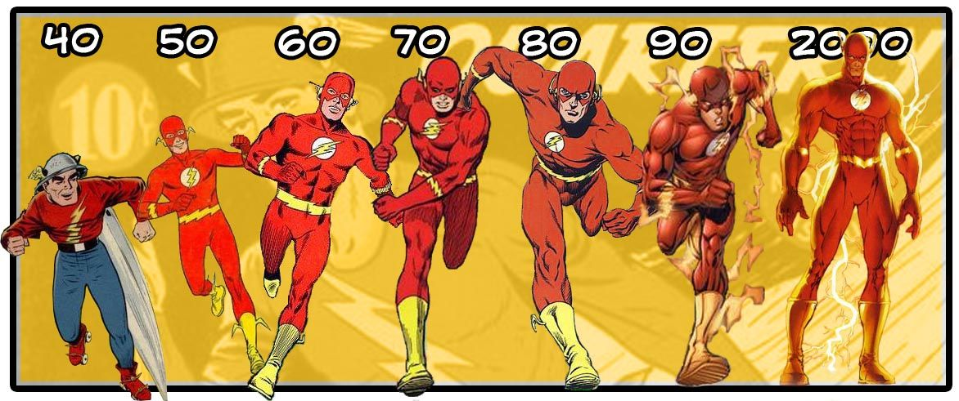
HIRING MATURITY
CHAOTIC
INCONSISTENT
SYSTEMATIC
STRATEGIC
Reactive, staying afloat
Sucessful individuals
Scalable proactive process, engaged teams
Data driven, winning candidate experience
#BabySteps
Notes:
Each of us has a different starting point in this workshop – some might be in the position as a hiring manager for the first time, someone else might have hired 50 people already. Simply speaking, our hiring maturity varies.
Some of you might already know the concept of maturity models. They help to assess the current state of knowledge and experience and they support figuring out what capabilities need to be acquired next to improve the overall performance. It’s important to understand that this applies not only to the personal level but also to the company level. We need to learn to crawl before standing up. We won’t master hiring in a day.
Figuring how to hire so it works for the company is a process that:
Takes time.
Requires strategic cooperation (management, hiring managers, teams).
Becoming a company that does hiring well requires defining who does what and why and how we can support each other and leverage our combined skills. It’s not uncommon that companies fight internally – hiring managers blame recruiters for delivering the wrong candidates, recruiters blame the business for not sharing enough information. That’s not the way to grow and if there’s anything important to be said today it’s the fact that hiring is a complex thing requiring the cooperation of all the people involved on many levels:
You ideally need to link your hiring strategy to the company strategy.
You need to be able to describe your culture well and be able to sell it.
You need to understand your values perfectly and be able to recognize them in your candidates.
You need to master your candidate requirements definition.
You need to handle your hiring data well so you can learn from past efforts.
You need to persuade all the people in hiring to actively participate in it.
And that’s just a couple of angles. Consider this training to be one step in this journey but the real work and the real improvement comes with practice and long-term cooperation between you, your teams and HR. This requires an open mind, time, effort and an ability to listen to each other. If you're interested, the maturity model we use is in the annex of your handbook – have a look at it just to realize the complexity of the agenda.

Slide 11
Y SOFT'S
HIRING PRINCIPLES
Not starting with why is the most efficient way to get lost.
- Simon Sinek -
Notes:
Now let’s talk about some basic principles we want to work toward. As already illustrated on the maturity model, we’re on the journey. That also means, we’re definitely not there yet. The good news is that we know where we’re heading. The same applies to the principles, which represent an ideal state of things. Sometimes we get closer, sometimes we’re really close and sometimes we fail.
Let’s start with a short exercise first (go to next slide).

Slide 12
DISCUSSION:
WHOM TO HIRE (and why)?
BRUCE
WAYNE
3 years of experience
Bit reluctant to accept the role
The team doesn‘t feel great about working with him
Fluent ENG
Has all the skills for the job
1,5 years of experience
Excited about Y Soft
Fits Y Soft 6A, team likes him
His ENG is rusty
Misses knowledge of a specific software we use but has experience with two others
Notes:
Present the “Bruce & Wayne” slide and have the group discuss whom would they prefer to hire and why.
There’s no right answer. Lead the group into concluding that they need to take into consideration business needs (Do I need a short-term contractor to deliver the work and leave?) Do I need someone who’ll stick with the company for the next 5 years and help shape it?) or anything else they come up with.

Slide 13
PRINCIPLE 1
We hire for potential and culture fit rather than for hard skills/experience.*
*While thinking about business needs.
Notes:
As we mostly hire for long-term roles and we highly value our culture, the recommendation is to stick to hiring more for potential and culture fit. There are several reasons for that:
#1 Experience ≠ performance. The fact the person spent the last 10 years doing the job doesn’t really mean they are a star in what they do. Also, being successful at one company doesn’t automatically mean you’ll star here since the environment can be dramatically different.
Go to next slide.

Slide 14
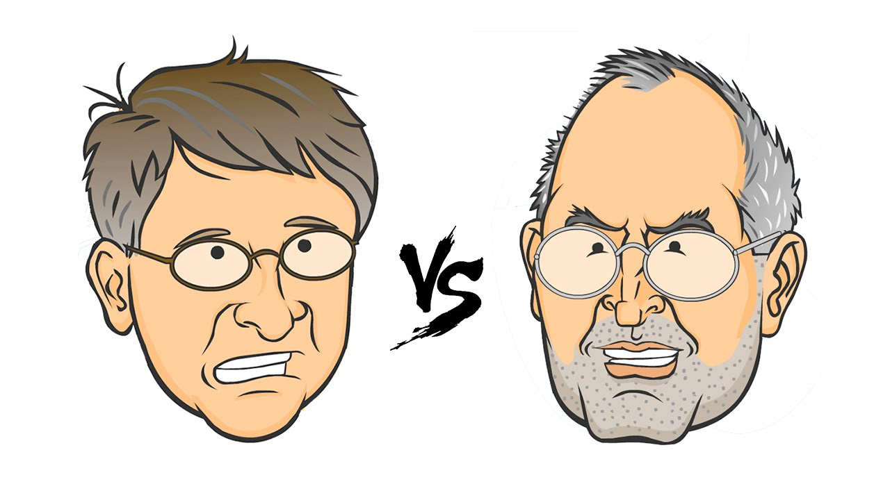
Notes:
#2 You can teach hard skills, but you will hardly change the attitude. Having an annoying person on board will cause much more trouble in the long run than finding a person who may need additional support at the beginning. Think back and try to remember all the people you had difficulty working with (have attendees actually think and ask them if they remember someone). Did they lack experience/hard skills, or did they lack the attitude/personality you were expecting?
To illustrate, think about two well-known figures – Bill Gates and Steve Jobs. There’s probably no doubt Bill had more experience when it comes to business and reading the market than Steve. He was more experienced, steady, no surprises. Steve failed tremendously several times, got tossed out by the board. But when it comes to innovations and really pushing things further, he was a visionary, and the fact that Apple took him on board again, even though he was definitely a pain, made Apple what it is now. The lesson learned is – the hard skills and experience are an important factor but you need to go much beyond them so you can be sure it will work – attitude and culture fit make a tremendous difference.
Ask the group if they have any more thoughts on the topic or any experience they could share.

Slide 15
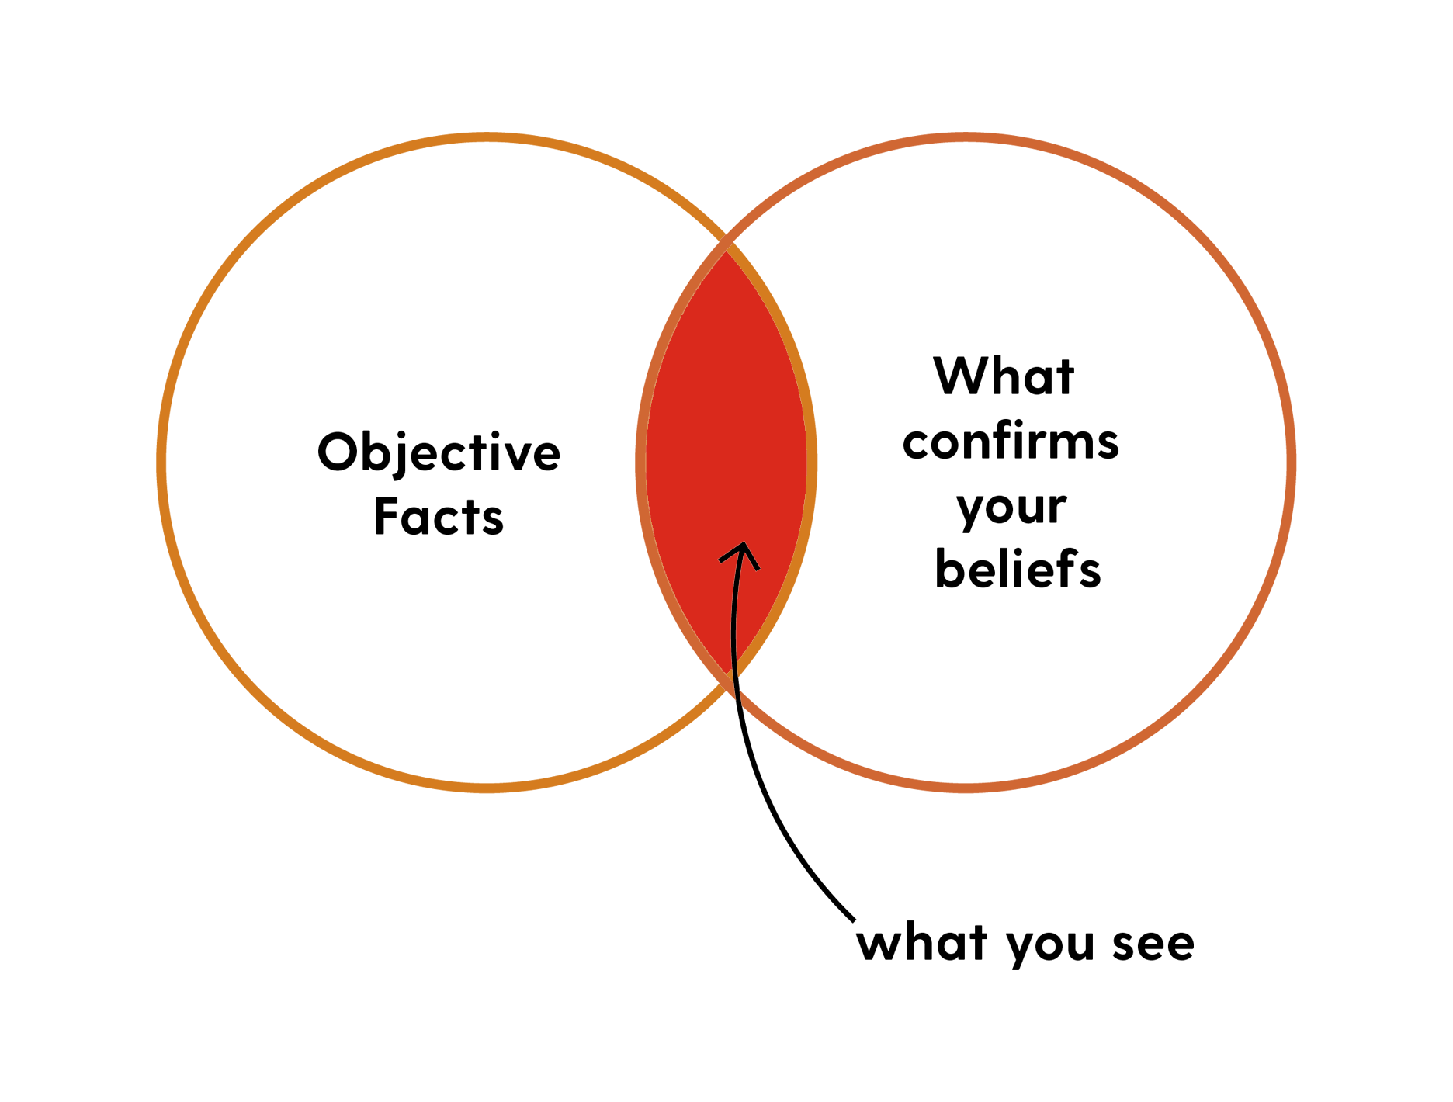
DON'T REINVENT THE WHEEL
People make snap unconscious judgment
Interviewers everywhere think they‘re good at interviewing
Everyone struggles with bias
Google, Slack, and AirBnB who do hiring well already know that STRUCTURED HIRING makes life much easier.
BOOM!
Notes:
Ok, next one! There are some things that we simply know because other smart people have already found it out. It would be just stupid to reinvent them or learn the hard way. So here’s one principle based on scientific facts and empirical experiences of many companies.
People are biased and we’re not naturally built for making hiring decisions. Since we’re social creatures, we tend to base our decisions more on previous experience and gut feeling than on what we see or data we collect. When interviewing a person, there’s more than 10 types of bias you can be sure you’ll suffer from. The other problem is that almost every interviewer in the world thinks they’re good at interviewing (meaning they are good at predicting how the person will perform) Again, this was proven to be wrong. They are just not. Google did quite an extensive research on that.

Slide 16
PRINCIPLE 2
We strive for inclusive hiring and try to limit any kind of bias.
Notes:
Fortunately, there’s a way out called structured hiring and we’ll speak about it more down the road. Put simply, structured hiring is about defining precisely what you’re looking for and then trying to keep the way you interview and evaluate candidates for the same role consistent.
Ask the group if they have any more thoughts on the topic or any experience they could share.

Slide 17
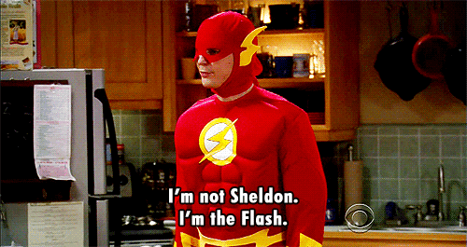
AUTHENTICITY
There‘s a thin line between powerful marketing and misleading. In hiring, misleading is a BIG FAT NO as it ALWAYS backfires.
Notes:
The last principle might seem rather straightforward, but every recruiter could easily pull out 10 different stories to confirm that the reality is different. While it’s very important to work with a candidate’s buy-in and overall candidate experience, you want to make sure that what you’re communicating about the job and the company is authentic, transparent and true. If you mislead them, you can be sure that not only their onboarding will be super hard since what they thought about the job, the company or you as their manager or colleagues will be constantly challenged by the reality but you can also harm the trust the person has toward you as a manager or the company itself.

Slide 18
PRINCIPLE 3
We aim for an extraordinary but authentic candidate experience.
Notes:
There’s a difference between a good candidate experience built on correctly set expectations, excellent communications and pleasant interviews compared to being overly positive about the role, the company and its challenges. Hiring is not a moment for fake advertising.

Slide 19
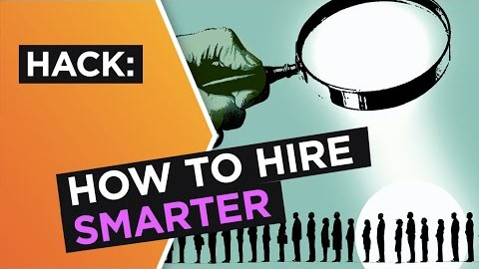
Notes:
And to wrap up the principles, here’s a short video from Simon that kind of sums it all.
Play the Simon Sinek video on successful hiring and ask the group if they have any inputs or thoughts.

Slide 20
3 KEY HIRING PRINCIPLES
PRINCIPLE 1
We hire for potential and culture fit rather than for hard skills/experience.
PRINCIPLE 2
We strive for inclusive hiring and try to limit any kind of bias.
PRINCIPLE 3
We aim for an extraordinary but authentic candidate experience.
Notes:
Have the group come up with the three principles to revise.

Slide 21
Coffee break

Slide 22
03
PROCESS
Flow, roles, tooling
Notes:
Ok, let‘s look into the hiring process now.

Slide 23
03 PROCESS
UNDERSTAND ALL THE ROLES
Every team needs a hero, every hero needs a team.
- unknown -
Notes:
We’ve already talked about the fact that hiring as a high-level company discipline requires cooperation on many levels. The same applies to hiring at the team level. When you need a new hire, this is the core hiring team.

Slide 24
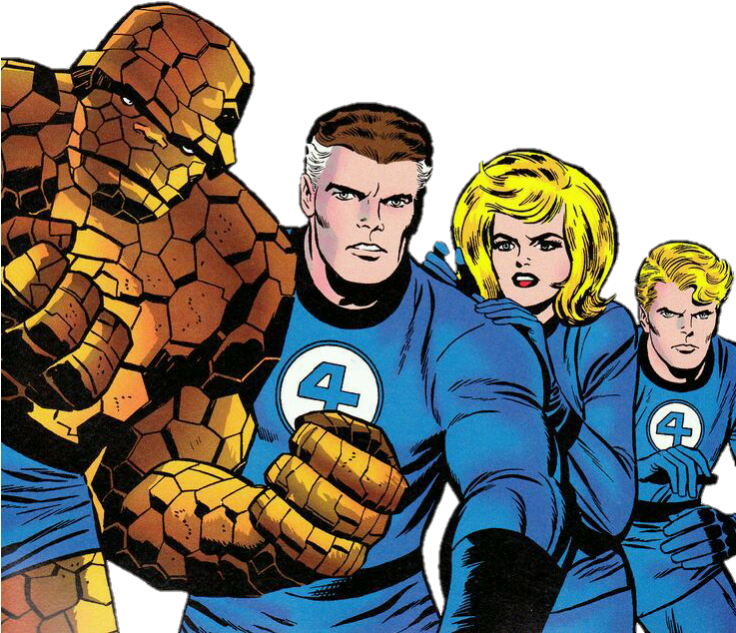
YOUR SQUAD
HIRING MANAGER/TEAM
Knows their current needs and the job perfectly
HR BUSINESS PARTNER
Knows the team & understands business context
RECRUITER
Masters the labor market, hiring process and candidate experience
Notes:
The critical roles in the hiring team are you as the hiring manager and your team or manager-less team, your HRBP and the Recruiter. Each possesses a different set of skills, knowledge and competencies needed for the hiring to run smoothly. You need to work closely, which requires quite a lot of communication (= time investment) and there’s a great advantage if you already know each other. That should be the case with your HRBP and we’re trying to do the same with recruiters whenever possible.
Hiring Manager/Team – you’re the only one person that understands perfectly the job you’re doing and the mission and context of your team, it’s also you who does the hiring decision
HRBP – is there to be your second brain when it comes to making people decisions – they should bring you additional input, help you figure out whom you need and what will help the team in the long run, all based on your past cooperation. Another important dimension of their role is that they link you with the rest of the company – they will help you figure out what’s the salary level for the new person and generally support you in the whole process of adopting a new member.
Recruiter – is the specialist who knows the labor market, knows perfectly how to handle the candidate experience and can guide you through the hiring process
Any questions?

Slide 25
WHO DOES WHAT?
HIRING REQUEST
CREATION & SUBMISSION
CANDIDATE
REQUIREMENTS
FORMULATION
SALARY RANGE
DEFINITION
VACANCY PROMOTION
INTERVIEWING
SOURCING
CANDIDATES
PRESELECTION
TOOLING
TRAINING
HIRING PROCESS
DESIGN
CANDIDATE FEEDBACK
JOB DESCRIPTION
DEFINITION
ONBOARDING
FEEDBACK LOGGING
FOR INTERNAL
PURPOSES
JOB OFFER
COMMUNICATION
HIRING PROCESS
ADMINISTRATION
ADD WHATEVER
YOU MISS
Notes:
Have the group sort out all the activities into HRBP/Recruitment/Hiring Manager or Team columns using a whiteboard and post-its or a Miro board. Have a discussion on each activity since most of these will fit into more than one column depending on the role (owner, consultant, etc.).
If there are any other activities identified during sorting, add them.

Slide 26
03 PROCESS
STEP BY STEP
Hold the vision. Trust the process.
- corporate God -
Notes:
Ok, now we know who does what so let’s put it on a simple timeline.

Slide 27
START WITH WHY
01
02
Official Hiring Request
Discussion with HRBP
04
Intake Meeting
Hiring Request Approval
03
06
Job Offer
05
Selection process
Notes:
Now we’re looking at something called the hiring process which you can find on Clerbo in detail. Now it’s not about you remembering all these steps by heart but understanding why we follow it.
Discussion with HRBP
If you think you might need a new person on your team because the workload is just higher, you miss specific skills or if someone leaves, the first person to go to is always your HRBP. You’ll have a discussion about the situation and if the conclusion is that you need to hire, they’ll be able to guide you further.
In all cases, you’ll need to start with defining the Job Description since it contains the information you’ll need for:
finding the appropriate salary level
Defining the business case for your new hire
the hiring request you’ll be sending to recruitment and your supervisors
and finally for the new hire employee contract
Official Hiring Request
Whatever it looks like (we used to do these annoying Excel forms, now it’s more in emails, we’re slowly inclining toward HelpDesk ticket), it serves two purposes:
informing the recruitment team about your hiring need
informing respective stakeholders that you plan to hire, whom exactly, why and how much the cost will be – for this reason the hiring request should be as complete and detailed as possible.
While it’s definitely possible to change requirements during the hiring process, any such change with impact on the final cost needs to be reapproved.
Hiring Request Approval
Once your hiring request reaches the recruitment team, they’ll create your requisition in the recruitment system Greenhouse. They’ll input the basic information – the cost of the hire, location, team, department, division, cost center and they trigger approval processes. For every new hire you need official approval of:
your Division Manager
the HR Manager
Why? It’s pretty simple – while the HR Manager is responsible for ensuring the whole company fits into the annual payroll budget (what we pay employees, including SHI, bonuses, meal vouchers, car allowance etc.), your division manager does the same for your division.
Two important things to know about the payroll budget:
Salaries are by far the biggest budget = biggest cost we have in the company – compared to Opex, Cost of Sales, Operations budgets etc.
another tedious thing about the payroll budget is that making cuts in it is not easy, not only on the personal level (because it effectively means letting people go) but also on the financial and time perspective level – imagine you put yourself in a situation when your payroll budget is too high and the company can’t sustain it anymore:
If you want to let people go because they’re too expensive, you’re still looking at two months’ notice period + usually 3 months of severance pay. That means that you can only reduce it only after 5 months and also the people won’t be working during this time, which again impacts the company performance.
Intake meeting
The intake meeting is where you, as the hiring manager/hiring team, meet your recruiter and usually also with your HRPB and you discuss the role, its advertising and hiring process design in detail. While you have your Job Description, which captures basic hard and soft skills, the recruiter will dig much deeper – what type of personality you’re looking for, how does a team fit look like for you, what kind of experience should the recruiters be looking for when preselecting, what are the selling points of the job and your team specifically.
Effectively, after that meeting the recruiter should be able to put together:
Candidate scorecard (set of criteria you’ll be using when interviewing your candidates)
The hiring process stages
The job ad and job promotion strategy
They will share with you all three of these, you’ll refine it and when you’re sure you understand each other perfectly, you’re off to a good start to begin the selection process.
Selection Process
The selection process differs from role to role and depends on what you’ve agreed upon on during the intake meeting. Usually, it’s the recruiter who does the preselection, initial phone screens and then it’s a combination of whatever you need – interviews, practical tasks, social rounds, on site visits. Mind that anything is possible if it makes sense both for you and the candidate.
Thanks to Greenhouse, you’ll be always able to see the stage your candidates are sitting in the pipeline. It’s the recruiters job to help you keep oriented in what’s happening and what you can expect next.
Job offer
You got your person? Perfect. After finding a consensus on the start date, salary and some additional details, the recruiter will prepare an official document called the job offer. The critical parts are the job title, JobDescription, supervisor, additional benefits, start date and job location.
It’s important to understand that the job offer is (almost) a sacred document. Once extended, there’s no actually no way to pull it back without legal consequences.
Again, every job offer must be approved.
If the job offer stays within the initially approved range, it’s only you and the HRBP who approves it. The HRBP checks it mainly because of internal equity (do we hire the new person on the correct salary level?).
If the offered salary goes beyond what was initially approved by the division and HR managers, you’ll need to get their approvals too.
It’s the recruiter who handles the job approval process for you – again we use GreenHouse for this so you always the status.

Slide 28

NEW HIRE!
CONGRATS!
Now the real "fun“ begins.
(Remember the "vicious“ circle...?)
Notes:
New Hire
If the candidate accepts the offer, we go for a beer, celebrate and then send all the details to the HR admin and Onboarding Specialists who’ll be there for you during the preboarding and onboarding phase. Please note that this is just the beginning – there will be a lot of work with getting ready all the preboarding and onboarding materials and, as we discussed it at the beginning, a successful hire doesn’t make a happy employee and team so you’ll need to step up your game while welcoming the new person in your team.

Slide 29
03 PROCESS
INTERNAL HIRING
Treat internal candidates like queens & kings.
- your HR team -
Notes:
There’s one distinctive chapter hiring and that’s internal hiring. We all realize that getting a new job or getting a new team member is tough when it comes to setting the right expectation, handling it so everyone feels ok and leaves with a good feeling about the company should they get the job or not.
Now this gets a million more times important when it comes to internal candidates. Why? Because we want them to stay. And they will. And to put it very bluntly, if you piss them off, it will backfire on many levels.

Slide 30
By default, a Y Softer can apply to any open position.
There never will be only "externally" opened roles.
Notes:
By default, YSofters can apply to any open position so there is never a role that is only available to external candidates. The fact they’re already working for the company can’t block them from applying. What you can do if you wish is to open the position to internal YSofters only. So effectively, you can select from internal and external applicants or only from internal applicants.

Slide 31
INTERNAL HIRING SHOULD BE EASY... ONLY THAT IT'S NOT
BRIGHT SIDES
RISKS
INTERNAL MOBILITY
EASY ONBOARDING
CANDIDATES EASY TO REACH
TONS OF REFERENCES
DISAPPOINTMENT
IF NOT SUCCESFUL
MISHANDLED FEEDBACK WILL BACKFIRE ON MANY LEVELS
CROSS-TEAM CAPACITIES
Notes:
There are bright sides to internal hiring – it supports internal mobility which is good for the company since people like to grow and gain new skills and experiences. Onboarding is easy since they already know the environment, they can also bring in useful input from other departments and divisions. The risk of a mis-hire is much smaller since there’s already tons of references. So generally, internal hiring is a good thing and companies with high internal mobility usually benefit from that.
On the other hand, you need to be super careful, transparent, and super fair when handling an internal applicant. The worst-case scenario is an internal employee applying for a role and suffering from a badly handled hiring process – should the trouble be its length, form, mishandled feedback or anything else. Also, it’s important to realize that when you do an internal hire, the hiring need will just move somewhere else. This is a small cost for a successful internal growth, but you might end up negotiating with the previous manager about the transfer date.

Slide 32
LIFE SAVING TIP #1
Stick to hiring principles and best practices twice as much as when hiring externally.
LIFE SAVING TIP #2
F2F
FAIRNESS & FEEDBACK
LIFE SAVING TIP #3
LIFE SAVING TIP #4
Trust HR and the internal hiring process.
Overcommunicate & be even swifter than you usually are.
Notes:
There’s a couple of tips that might help with internal hiring.
Stick to the hiring principles and best practices twice as much as when hiring externally. There’s no more to say.
Fairness & Feedback. Transparency on all the levels includes proper communication to the company that you’re opening an internal role, giving everyone the same chance to apply, treating all the candidates the same regardless if you know them – they might eventually end up comparing their experience. Mastering the feedback. The people need to understand why they are or why they are not accepted.
Trust HR and the internal hiring process. When it comes to internal candidates, we follow the internal hiring process which differs in two details:
We encourage the employee to discuss their decision to apply for the role with their current manager
We organize F2F feedback sessions after the interview, making sure the employee understands and accepts the outcome and also sees other options how to grow in Y Soft
Overcommunicate and be swifter than you usually are. Just try to prevent delays or uncertainty as it severely impacts other teams in Y Soft and the YSofters in the process.
Any questions or inputs?

Slide 33
03 PROCESS
TOOLING
If the only tool in your toolbox is a hammer, everything looks like a nail.
- some smart & observant guy or girl -
Notes:
Last but not least in this section – quick introduction to tooling.

Slide 34
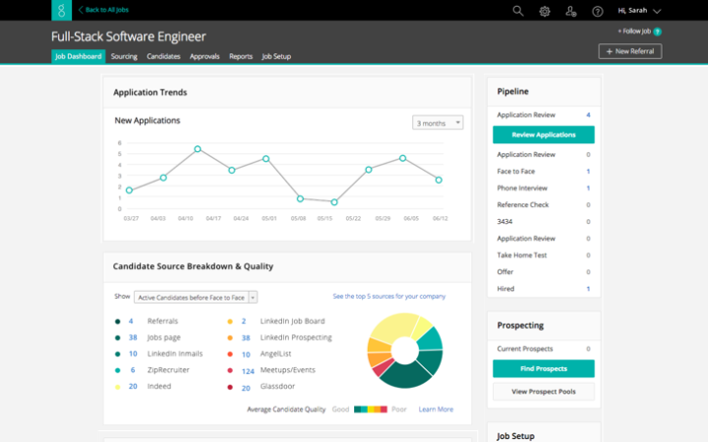

TOOLS SHOULD WORK FOR YOU
GREENHOUSE is where
Y Soft grows its talent.
Combine with whatever works for your squad (Webex, Teams, emails) while avoiding unnecessary double work.
Notes:
Since we’ve mentioned Greenhouse several times, here’s some details. Y Soft has recently adopted an applicant tracking system called Greenhouse. Companies use these systems for several purposes:
Tracking all the candidates, logging outputs of interviews and selection processes
Collecting data not only for recruitment analytics but most importantly for planning and forecasting payroll costs
Making the sharing of information in hiring teams easy – everything you need is on one place, accessible any time via SSO
Easy design of their recruitment processes
And many more
Every YSofter participating in a recruitment process will be properly trained to use the system. No worries, it’s a web app, quite intuitive and it’s not rocket science.
Of course, feel free to combine Greenhouse with whatever works for you – sometimes it may help to set up a dedicated Teams/Webex channel for quick operational comms etc. The only thing you want to avoid is double work so please – there’s really no point in sending your feedback about a candidate in email when you can and you should use the scorecard in Greenhouse.
Provide a quick GH tour – open Testing & Training role, show candidate pipeline, interview kit, scorecard and couple of reports.

Slide 35
Lunch

Slide 36
04
BEST PRACTICES
Candidate requirements, interviewing, bias
Notes:
Now to the more practical stuff!

Slide 37
CANDIDATE REQUIREMENTS
O4 BEST PRACTICES
What do we say to change in requirements? Not today!
- Arya Stark (almost) -
Notes:
Put simply, job requirements are skills, experience, and qualities you consider necessary for the role. They are an important part of any job description. When done correctly, they work as a preliminary determinant for the fit for the role. The recruiter uses them to deliver you candidates that meet your expectations and wraps their interviewing process around them. It’s extremely important for the hiring team to be aligned on them all the time. When things go wrong and you don’t get the candidates you want, you usually circle back to the requirements, refine and start over.

Slide 38
DON'T YOU DARE MIX A JOB DESCRIPTION WITH A JOB AD
JOB DESCRIPTION
JOB AD
TELLS
INTERNAL AUDIENCE
DEFINES THE ROLE AND REQUIREMENTS, NO EMOTIONS
SELLS
EXTERNAL AUDIENCE
DESCRIBES THE ROLE IN BRIGHT BUT TRUE COLORS
Notes:
A quick introduction to hiring terminology since that’s usually where a lot of confusion happens. When we want to hire a person, we start with a job description which is a formal, a bit boring, but important internal document that captures the scope of the role (what they do, what they’re responsible for) and candidate requirements (skills, experience, qualities needed for the job). This document is not used for hiring only – we use it to determine the person’s salary, we revise it when we promote people, we revise it when we change the scope of the role for existing employees.
The job ad is something we put out to attract candidates. It’s marketing text. It can be emotional; it can contain more or on the contrary less information – anything that fits your purpose.
Your primary responsibility when hiring is the job description including requirements, that’s what matters and that’s what you put together as the first thing when discussing your hiring intention with HRBP. It’s the recruiter’s/marketing responsibility to create the job ad – you’re definitely welcomed to participate but putting together the Job Description is usually where you bring the most important value.
Now let’s proceed to some advice regarding those candidate requirements:

Slide 39

NOT A WISH LIST
"5 years Java, 7 years Python, business acumen, PhD in Economy, great negotiator, ACCA Master Finance, saved the world twice already...“
Notes:
The list of job requirements is not a wish list. You should always stand firmly on the ground when formulating requirements. This doesn’t mean not being demanding but you should always keep in mind that finding Batman is much harder than finding Robin and training him. If you want to formulate nice to haves, indicate they’re nice to haves. By having too many requirements, you limit the pool of candidates you’ll get to see and sometimes you might miss great hires. Companies good at hiring usually know that you need to be creative and think backwards a bit – you have a great candidate? Ok, let’s see what we can do so we design them the right job.

Slide 40

BE SPECIFIC
"The main requirement for this role is FLEXIBILITY“.
Notes:
It’s always better to list specific requirements than vague ones. Be as much specific as possible. Instead of going for communication skills go for presentation skills, negotiation skills, writing skills, active listening - just really think about the daily work of that person. Your HRBP and Recruiter should help you to do this since this information is essential for them to understand whom you’re looking for.

Slide 41

DIG DEEP SO YOU CAN MEASURE IT
"SENIOR FINANCE EXPERT“
Notes:
This goes hand in hand with being specific but with every requirement you should have an idea how you will measure that the candidate has it. Instead of “senior finance expert” you can go for experience with specific finance agendas and their scale like “experience with handling P&L reporting for a global company, etc.”

Slide 42

CANDIDATE REQUIREMENTS
Score
card
JD
Score
card
JD
HARD SKILLS
01
02
SOFT SKILLS
CULTURE & TEAM FIT
03
04
PRACTICAL
DETAILS
Score
card
Score
card
Notes:
When thinking about the requirements, you can use following structure – remember we’re talking about Job Description requirements:
Hard skills are teachable/measurable abilities - e.g. knowledge of human/programming language, usually the hard skills are a result of some kind of experience or education.
Experience – always list specific skills or agendas than generic "6 years in the field" as there’s no proof that having that experience equals having those skills.
Education – include it only if it‘s a must (specific certification etc.) – the same principle
Translating your requirements from a job description to a job ad should be the master skill for your recruiter. It may happen that at the end they will use something like education or experience in the requirements section of the job ad so it’s easier for the candidates to relate to the job ad so make sure that what you’re using in the job description and subsequently in the scorecard is measurable and is really proof that the desired skill is there.
Soft skills - relate to how you work and interact with people – e.g. negotiation, presentation, active listening. Now, we’ve already talked about the need to be specific here so we want to avoid vague requirements such as “great communicator” of “good soft skills”. A good way to be specific is to imagine situations that will require such a skill and try to name them properly.
Culture & Team Fit – while some things will be derived from the company culture (YS 6A), others might be role or team specific. If you want to do a culture assessment based on YS 6A your recruiter will help you to put together an interview section designed specifically for that. Some teams prefer to do this differently and we generally do not enforce YS 6A assessment. The message here is that while culture fit is extremely important, there are more ways to check it, we’re not dogmatic about YS 6A and it’s up to your agreement in the hiring team how this will be done.
Practical details – that’s really like everyday stuff - willingness to travel, work on shifts whatever is needed for the job.
As for hard skills and soft skills – that’s what you usually put in the job description. When you transfer your job description to a scorecard that’s what you’re consistently using when assessing your candidates.

Slide 43
STRUCTURED
HIRING & BIAS
O4 BEST PRACTICES
We don‘t see things as they are. We see things as we are. –Anais Nin-
Notes:
Now when we know who we’re looking for, let’s look into how to do the interviewing part. We’ve already discussed principle 2 “We strive for inclusive hiring and try to limit any kind of bias”. Sounds simple, but it’s not. The barrier we need to overcome is called “Interview Bias” and “trying to limit it” is not easy at all.

Slide 44

Notes:
To get on the same page and understand what a bias is, let’s watch this short video.
Have a short discussion on some of these questions:
Have you ever found yourself in a situation of being biased? Have the group share their experience.
When bias, diversity and inclusiveness is discussed, do you stick to obvious categories like gender, ethnicity or age or do you also think about other types (first impression, affinity etc.)?

Slide 45

COMMON
TYPES OF
INTERVIEWING
BIAS
FIRST IMPREESION BIAS
AFFINITY
BIAS
CONFIRMATION
BIAS
Notes:
These are 3 common types of interview bias.
First impression bias – the candidate walks in the door, they look great, they sound great, we unconsciously jump to the conclusion they will be great. We’re strongly influenced by the very first piece of information we receive. It makes us less diligent.
Affinity bias - If we share an affinity or quality with the candidate, we assess them in a better light (you studied at the same university, they have similar hobbies, you worked at the same company etc.)
Confirmation bias – we unconsciously seek only the information that support our early finding or assumptions about the candidate. Also, we under-weigh, undervalue or ignore the information that might conflict with them.

Slide 46
Preventing bias completely is not possible, the only thing you can do is to learn how to work with them efficiently.
Here‘s what you can do:
- Accept being biased
- Monitor each other while assessing candidates
- Slow down the decision making process
- Stick to STRUCTURED HIRING
Notes:
Biases will always be there; it’s just how our brains work. There’s no way for them how to not be there. Now let’s talk about how to work with them.
Know about them – the first step is accepting the fact they’re there and having the intention to work with them.
Discuss them with your fellow interviewers, monitor each other – it's ok to help others to work with biases consciously.
Slow down the decision making - don’t rush, write things down, verbalize gut feelings.
Stick to structured hiring – the recruitment team can help you with this.
Now we finally get to structured hiring.

Slide 47
THE MAGIC OF STRUCTURED HIRING
CLEAR & STABLE SET OF
REQUIREMENTS
CONSISTENT SET OF QUESTIONS
CONSISTENT INDIVIDUAL SCORECARD
Avoid changing requirements in the process. If must be, do that consciously.
It‘s hard to compare without ensuring the same conditions for everyone.
Fill your own before sharing with others immediately after the interview.
Notes:
The idea behind structured hiring is simple. It starts with a set of solid, verifiable requirements. Based on that you develop an interview kit – a set of questions with interview structure, precisely defined to verify what you’re looking for. The deal breaker here is to use the same set of questions for every candidate you assess for the role. Another part of the interview kit is a scorecard which will help you summarize your feedback closely tied to the requirements you were focusing the interview upon.
The best practice is to definitely fill in the scorecard before debriefing and sharing your ideas with others.
Present a sample scorecard.
The fact that structured hiring is more predictive and so far the safest way to get close to a good candidate and interviewer experience has been confirmed by many different studies (your learning materials contain links for further reading, research and case studies). So far the biggest described and documented “in practice” experiment happened in Google who tried it, verified it works and decided to stick to it.
Btw, in addition to finding out that structured interviewing works the best, they also found out other facts, e.g. that there’s no linear relationship between the number of interviews (or interview stages) and the level of candidate success predictability. They concluded that after being interviewed by 4 people, the level of new information gathered significantly drops. This resulted in the fact that they never conduct more than 4 interviews, whatever the role is (Laszlo Bock: Work rules).

Slide 48
INTERVIEWING
O4 BEST PRACTICES
- What‘s your biggest weakness?
- I used to be really conceited, but now I‘m just perfect.
Notes:
In this section we’ll cover some of the more but also less obvious interview practices.

Slide 49
INTERVIEW
NO GO ZONE
AKA
WE MIGHT GET SUED IF...
BASE YOUR DECISION
OR ASK QUESTIONS
CONNECTED WITH:
RELIGIOUS BELIEFS
SEXUAL ORIENTATION
FAMILY SITUATION
POLITICAL OPINIONS
PHYSICAL/MENTAL HEALTH
ETHNICITY
AGE, GENDER...
BOOM!
Notes:
Let’s start with the legal minimum. We need to say that we don’t follow these principles just because they are required by law but also because we believe it’s a good and ethical thing to do.
While interviewing, you should never ever base your decisions or even take into consideration the following factors:
Religious beliefs of the candidate
Sexual orientation of the candidate
Family situation of the candidate (marital status, children...)
Political opinions of the candidate
Physical/mental health of the candidate
Ethnicity of the candidate
Any other discriminatory factors such as age, gender etc.
It’s important to understand that direct questions about these factors are forbidden and you need to also be careful about all remotely connected/indirect questions such us "Is there someone to take care of your children in case they’re sick?" as an alternative to "Do you have children?“ The principle is key here.
The simple advice is to stick to skills, personality and experience. Questions?

Slide 50
CANDIDATE EXPERIENCE
# 1 The competition is fierce and the talent pool small. The one who gets the right people on board wins.
#2 Bad hiring experience is an entry ticket to vicious circle.
#3 Good experience doesn‘t mean easy interviews.
evp
Notes:
We've talked quite a lot about defining requirements correctly, having the right interview structure and so on in order to make a good hire. However, that’s only one part of the hiring equation and one which reflects only the interest of the company. It’s also important to realize that offering and accepting a job is a standard business situation where two equal partners – the employer and the potential employee shake hands. Meaning it’s equally important to provide the candidate with enough time and space to find out what they need to know about the company, the job and the team.
There are several reasons why a good candidate experience matters, some related to the job market, others related to sustainability of hiring.
The current unemployment rate in the Czech Republic is around 3%, which basically means that everybody who wants a job, has a job. The supply of vacant jobs is much higher than the demand. There are many companies fighting over the same talent. And obviously, it’s hard to deliver if you don’t have the right people on board.
Also, a bad hiring experience usually puts both onboarding and retention of the candidate at risk (e.g., if you build some false expectation, if it takes too long, if the feedback is not precise etc.).
Striving for a good candidate experience is sometimes misinterpreted as having easy interviewers but that’s not the case. Generally, what matters most is the overall hiring process management and hiring culture.
Present the EVP mark.
There‘s also a small thing called the Y Soft‘s EVP which is essentially a set of descriptions of Y Soft as an employer we consider to be unique. The employer branding team uses them to tone all the communications, visuals. We consistently use these descriptions in campaings and candidate communication. The ideal case scenario is that all YSofters understand it the same and can relate to it and work with it, The middle ground scenario is that people participaiting in the hiring process know it and use it. We offer another training designed to learn how to work with the Y Soft EVP and you‘ll also find the EVP in your handbook.

Slide 51
WHAT MAKES A GOOD CANDIDATE EXPERIENCE?
WELL MANAGED
EXPECTATIONS
PARTNER APPROACH
TRANSPARENCY
HONESTY
SWIFT PROCESS
TIMELY COMMUNICATION
PROPER
TRACKING
FEEDBACK
TECH HACKS FOR
SCHEDULING
AND THAT
AND ALSO
AND THIS
Notes:
You generally want to make sure that:
The candidate has well managed expectations – not only about the job, the company and salary but also about the hiring process itself – they always know what comes next, how long it will take etc.
You treat candidates as partners, equals since that’s what you are – interviewing is not an inquisition but a dialogue.
You’re 100% transparent about the job, the candidate position about the process and all connected development.
You aim for a swift process and timely communication. Nobody likes to wait.
Providing good feedback that the candidate can work with is essential. The holy grail is a rejected candidate thanking you for what they learned about themselves.
You collect feedback from candidate as well so you can continuously improve what you do.
Any additional ideas?

Slide 52
GETTING READY FOR THE INTERVIEW
WHY YOU?
WHY THEM?
Read the interview kit and know your role
Get familiar with the candidate‘s profile
WHAT DO WE SEEK?
SYNC
Get familiar with the scorecard – what are you Supposed to learn?
With other interviewers and the recruiter
Notes:
Now getting to the interview itself. Before any interview you should always follow this simple checklist.
Read the interview kit and know your role – it's important to understand what’s your role in this specific interviewing process – are you the only interviewer? Are you one of many? How much time do you have? What are you supposed to share?
Get familiar with scorecard (= requirements). What are you supposed to learn and how do you plan to do it?
Get familiar with candidate's profile - this is not as important as it might sound but it might help you to focus your questions around their previous experience
Sync with the Recruiter and other interviewers - who’s going to focus on what and why?

Slide 53
THE SUBTLE ART OF ASKING THE RIGHT(?) QUESTIONS
Have you ever worked with SAP?
Do you find working in a fast paced environment challenging?
Do you enjoy working in a team?
Did your last position require dealing with senior stakeholders?
Why should we hire you?
Where do you see yourself in 5 years?
Are you more of a hunter or a gatherer?
Do you believe in Bigfoot?
How honest are you?
Notes:
Now the tough part - the actual interview and how to ask the right questions. We’ve already talked about interview biases and how to work with them – knowing how to ask a question so you don’t get a biased answer steps up your game. Let’s start with simple exercise of discussing if the following questions are suitable for interviews.
Discuss each question, make a conclusion about its risks and find a suitable alternative if needed.

Slide 54
QUESTIONS BEST TO AVOID
CLOSE-ENDED QUESTIONS
LEADING QUESTIONS
QUIRKY WANNABE-GOOGLE QUESTIONS
Notes:
To wrap it up, these are the questions you generally want to avoid or reduce (don’t worry, you’ll always ask them partially, sometimes even intentionally):
Closed-ended questions
Leading questions
Quirky wannabe-Google questions
As for the last ones (E.g. "If you were an animal which one would you be and why?“ or "How many golf balls can fit in a school bus?“ or "What’s the color of success?" or "How would you solve problems if you were from Mars?") - Try to avoid these unless you’re perfectly familiar with their methodology (you know what you’re validating/testing by using them and how to analyze the answer). If you’re about to crack one of these questions, discuss it with the team prior to the interview. Always bear in mind the candidate experience. Experiment carefully, wisely and consciously.

Slide 55

Notes:
If you’re a beginner to interviewing, focus on your questions. That’s your 101, that’s what you need to master in the first place. If you’re a pro or if you think you’ve got enough headspace, start with sharpening your active listening. Mastering your active listening is a long journey. For some people it might come easy, for others it can be quite hard.
Discussion: How do you understand active listening? What does it consist of? Write down all the suggestions.
Ok, let’s start this with a short video of a conversation. Try to observe how the communication style changed in the middle of the sequence and what was the effect. In the video (hyperbolic though), Amy switches on her active listening and we can see the dynamics of the social interaction immediately changes.
Discussion: What did she do differently? Write down all the observations

Slide 56
LISTENING (PREFERABLY ACTIVE) IS PART OF THE INTERVIEW TOO
ENCOURAGE
PARAPHRASE
REFLECT
"Feel free to ask questions...“
"So what I‘m hearing is that...“
"I see this is quite important for you.“
SUMMARIZE
APPRECIATE
DON‘T JUDGE
"So far we‘ve talked about...“
"This example helped me to understand...“
"I don‘t think you made a good decision...“
Notes:
So first of all, she paid attention non-verbally – she kept a reasonable amount of eye contact, and was not distracted by anything else (e.g. in her case the dinner, in your case checking your phone during the interview etc.) But further she:
Encouraged him – either directly (“Tell me more”) or indirectly by expressing sympathy (“No way!”)
Paraphrased – repeated what he has already said
Reflects – mirrors his feelings (“That must be hard for you!”)
Another set of useful techniques are:
Summarization
Appreciation
There’s one more piece of good advice – Don't judge! When you judge, the communication partner usually recognizes it immediately and will react to that.
It’s important to understand that we need to balance these and use them wisely. You should understand these competencies as tools that you can use if they’re needed – do you need to dig deeper? – encourage. Do you need to build trust and feeling of understanding? - encourage, reflect. Do you need to clarify? - summarize.
On the other hand, if you want to observe the candidate’s social skills and ability to handle pressure, work with silence. Just let them react to when you are not saying anything.
Discussion: Are they any other useful techniques you use during your interviews? Share.

Slide 57
Coffee break

Slide 58
05
TRY OUTS
Ain‘t no learning without training

Slide 59
A. HIRING PROCESS DESIGN
Based on provided business situation, define a profile you‘d like to hire. Put together candidate requirements.
Conduct an intake meeting with the recruiter and design the whole hiring process. The Recruiter will be there to revisit your requirements and guide you when designing the hiring process.

Slide 60
B: INTERVIEW ROLEPLAY
Based on provided JD, candidate profile and interview kit, conduct a short interview.
The rest of the team helps to come up with questions and provides the interviewer with feedback on their questions.
Switch roles so more people can try interviewing.

Slide 61
06
WRAP UP
This is just the beginning!
Notes:
Ok, this is the end of today’s sessions. You’ve done a great job. As discussed at the beginning – remember the maturity model, learning curve and the fact that becoming a pro in hiring requires time and coordinated effort of all the people on the hiring team. Ask for feedback, share feedback – that’s how you’ll grow. Another way is definitely to do some self-study – your handbook offers tons of additional materials and if it fails to meet your needs, there’s always your recruiter, HRBP or old-fashioned Google.

Slide 62

THANKS
Questions?
Reach out to your HRBP or Recruiter
2021

Slide 63


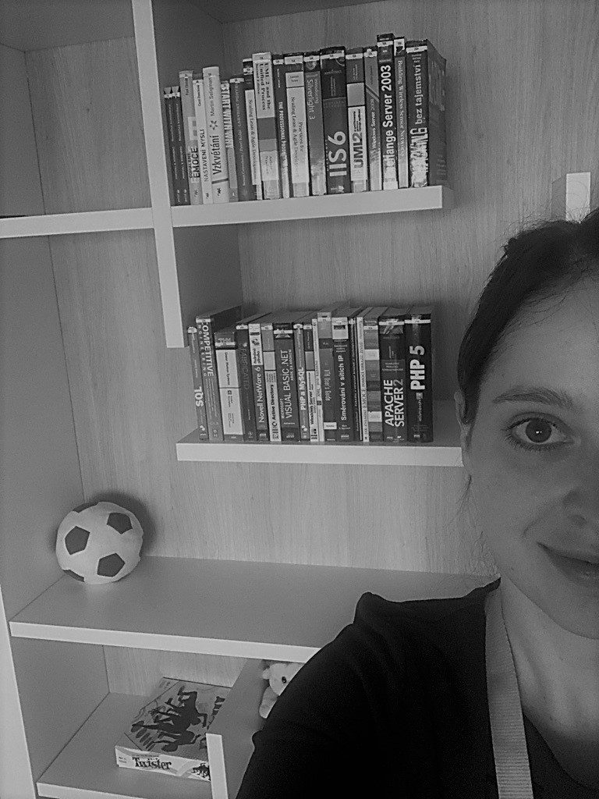
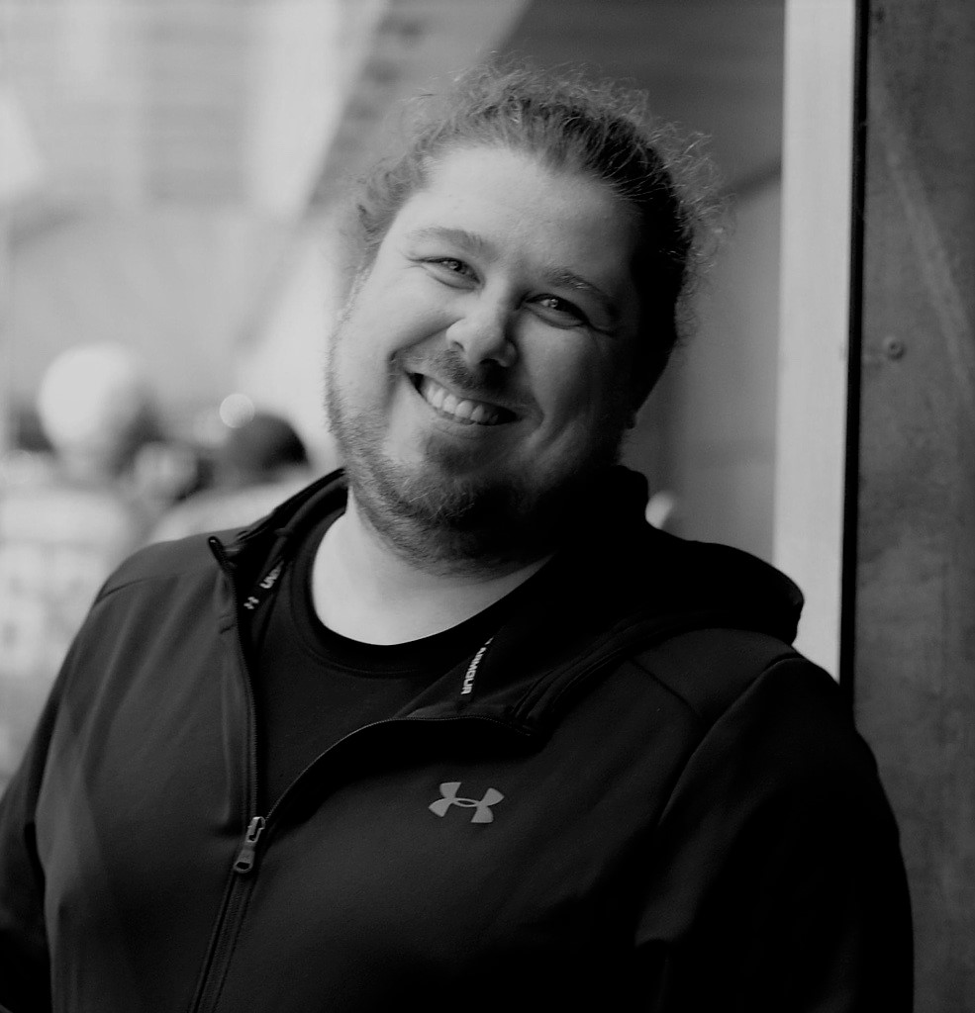

Created by:
Lucie Chladová
Y Soft Recruitment Lead
Tereza Sloupenská
Y Soft Recruitment Lead
Vladěna Nováková
Y Soft Recruiter
Marek Haládik
Y Soft Recruiter
Jaroslav Bělehrad
Y Soft HR Manager

Slide 64
Sources cited
Big Think. (January 3, 2020.) Hiring hack: How to better evaluate your candidates | Simon Sinek | Big Think (Video File). Retrieved from https://www.youtube.com/watch?v=dO6X_NwrpSA&ab_channel=BigThink
The Royal Society. (November 111, 2015.) Understanding unconscious bias (Video File). Retrieved from https://www.youtube.com/watch?v=dVp9Z5k0dEE&t=6s&ab_channel=TheRoyalSociety
Škola Kitajgorodskoj / Warner Bros. Television (October 18, 2016) The Big Bang Theory Active Listening (Video File). Retrieved from
https://www.youtube.com/watch?v=3_dAkDsBQyk&ab_channel=%D0%A8%D0%BA%D0%BE%D0%BB%D0%B0%D0%9A%D0%B8%D1%82%D0%B0%D0%B9%D0%B3%D0%BE%D1%80%D0%BE%D0%B4%D1%81%D0%BA%D0%BE%D0%B9

